Slide 1






Mountain Housing Council
Innovative Policy Meeting
March 26, 2018

Slide 2

Introduction
John B. Hester, AICP
  TRPA Chief Operating Officer
  Citygate Associates Senior Associate
  Reno Assistant City Manager, Community Development Director
  Washoe County Community Development Director

Slide 3
Overview
Investor/Developer/Customer Perspective
  Predictable
  Consistent
  Timely
Performance Audit
Self Improvement

Slide 4
Performance Audit
Process
Balanced Scorecard Framework
Stakeholder Input

Slide 5
Performance Audit Process
Internal and external stakeholders assessment:
○ Elected Officials
○ Staff
○ Customers and other stakeholders
Identification of key themes.
Using key themes, comparison of the community development divisions and programs to best practices.
Preparation of findings and recommendations for each of the key themes.
Preparation of Action Plan and report.

Slide 6
Stakeholder Input
Key Themes
Elected Official Interviews
Focus Groups
Staff Interviews
Customer Interviews
Employee Survey
Online and Printed Information
Customer Survey

Slide 7
Balanced Scorecard Framework

Slide 8
Self Improvement
Process
Checklists
Measures
Tracking
Reporting
Mentoring/Teaching

Slide 9
Process

Slide 10
Process
MOU Delegation & Coordination
Information & Education
Applying for a Permit
Plan Reviews
Inspections

Slide 11
Process

Slide 12
Checklists

Slide 13
Measures

Slide 14
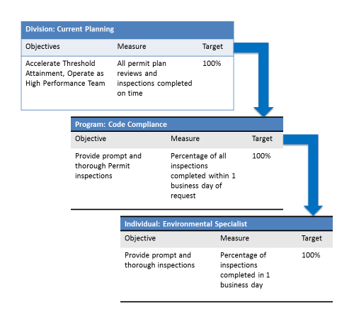
Measures

Slide 15
Tracking

Slide 16
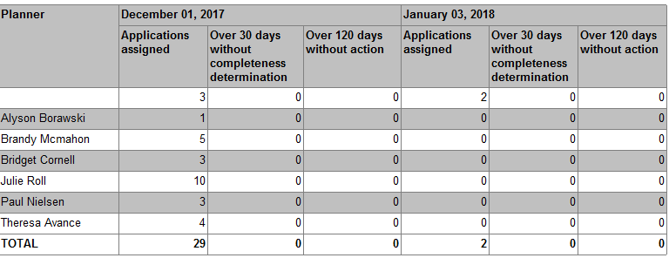
Tracking

Slide 17
Reporting
Month | Total Applications | Total Late* | Percent on Time
September 2015 | 759 | 15 | 98.0
October 2015 | 1,167 | 17 | 98.5
November 2015 | 731 | 8 | 98.9
December 2015 | 857 | 17 | 98.0
January 2016 | 587 | 14 | 97.6
February 2016 | 789 | 7 | 99.1
March 2016 | 924 | 37 | 96.0
April 2016 | 912 | 12 | 98.7
May 2016 | 880 | 49 | 94.4
June 2016 | 925 | 26 | 97.2
July 2016 | 638 | 22 | 96.6
August 2016 | 911 | 18 | 98.0
September 2016 | 997 | 10 | 99.0
Cumulative | 11,077 | 252 | 97.7
* At least one reviewer held application for 11 working days or longer

Slide 18
Shared Learning

